Slide 1
Workout Split Manager
CS 1103 Project Presentation Vihaan Dumont – 3761518 Darin Thomson -
Abdel -
Dwyane -

Slide 2
Workout Split Manager is a
Java desktop program that schedules and coordinat es personalized fitness routines for multiple users. It simulates a live gym environment where each user follows a systematic 5-day
workout routine based on his/her goal, membership status, and available days.
Introduction
With Java, SQLite, and JavaFX,
the program demonstrates the integration of a relational database and a graphical user
interface. In the backend, there are well-normalized tables such as Users, Workouts, Exercises, MuscleGroups, and WorkoutExercise, and the frontend provides interactive
data visualisation through styled table views and buttons.
One of the strengths of this project is its randomization mechanism for data, wherein exercises are
dynamically created and assigned to each
user with an eye towards variety and customization. This project focuses on the practicality of database design, ER modeling, and Java programming skills in a real-world fitness management context.

Slide 3
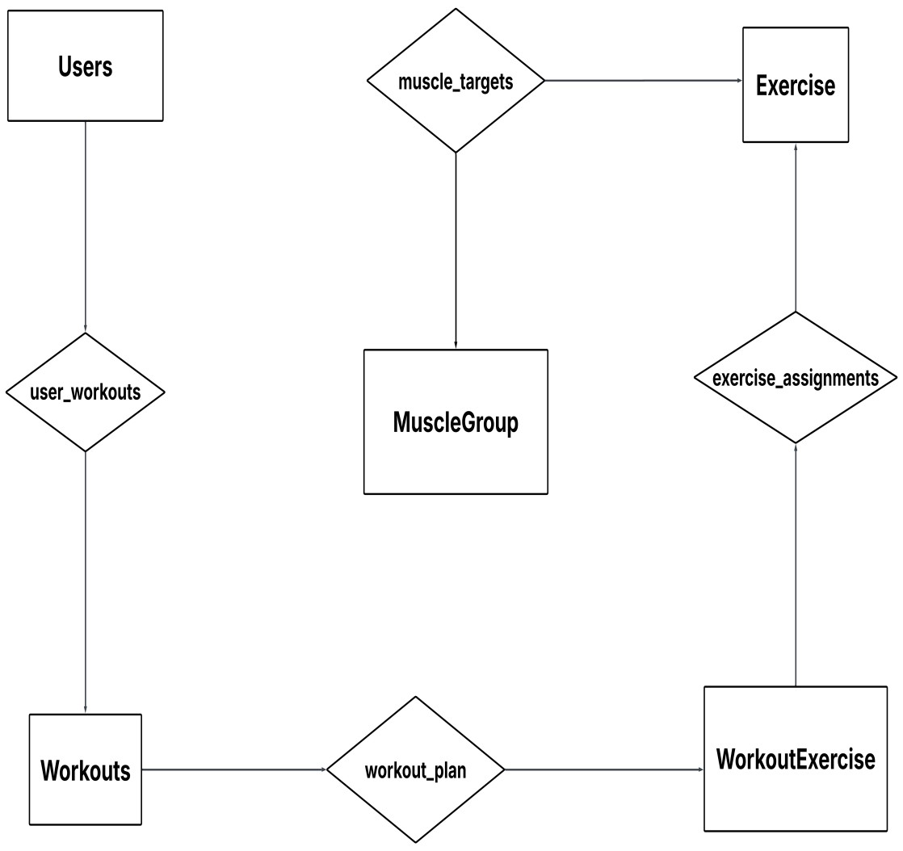
ER Diagram

Slide 4
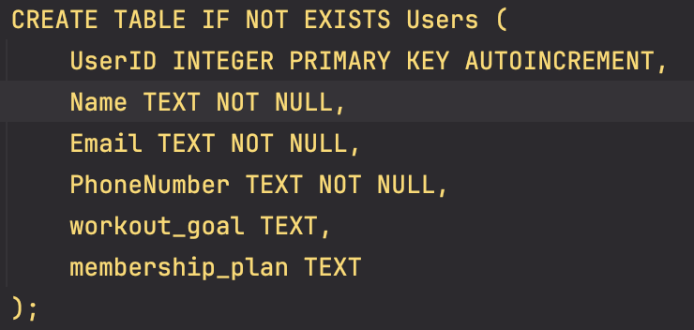
SQL DDL: Users

Slide 5
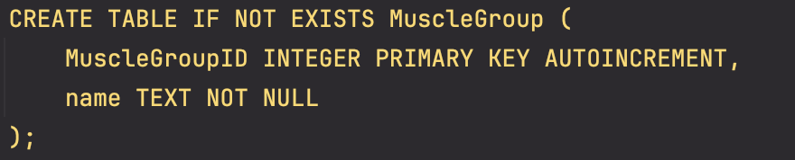
SQL DDL:
MuscleGroup

Slide 6
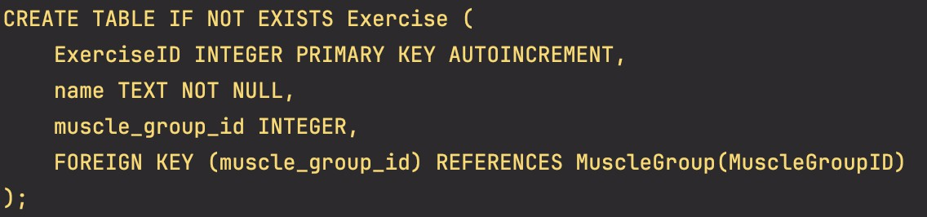
SQL DDL: Exercise

Slide 7
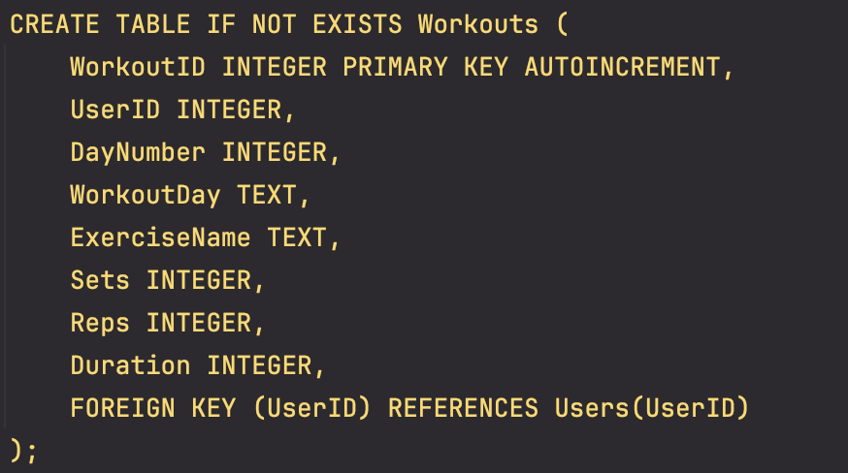
SQL DDL:
Workouts

Slide 8
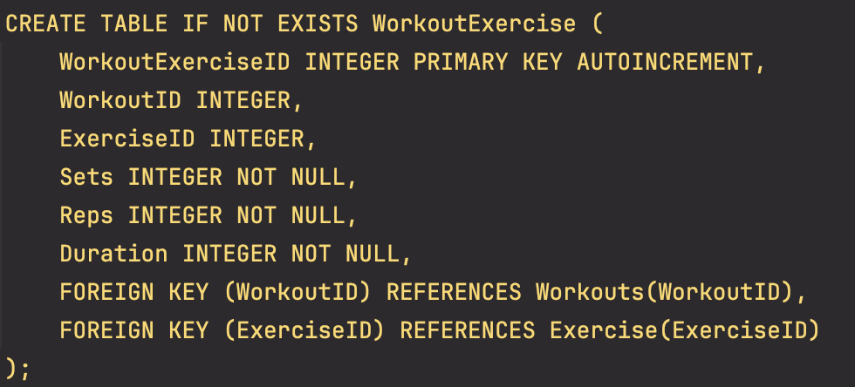
SQL DDL:
WorkoutExercise

Slide 9
Foreign keys enforce integrity across linked tables
Example: UserID in Workouts references
Users(UserID)
Ensures each workout is connected to a valid user
WorkoutExercise handles many-to-many relationships
Between Workouts and Exercise
Allows multiple exercises per workout and vice versa
MuscleGroup organizes exercise categories
Each exercise can target one specific muscle group
Enables structured categorization of exercises
Workouts are linked to users via foreign key
Each user can have multiple workouts
Personalized plans are assigned using UserID
DDL to ERD

Slide 10


Sample INSERT Statements

Slide 11
Connection conn = DriverManager.getConnection("jdbc:sq lite:workout_split.db");
JDBC Connection

Slide 12

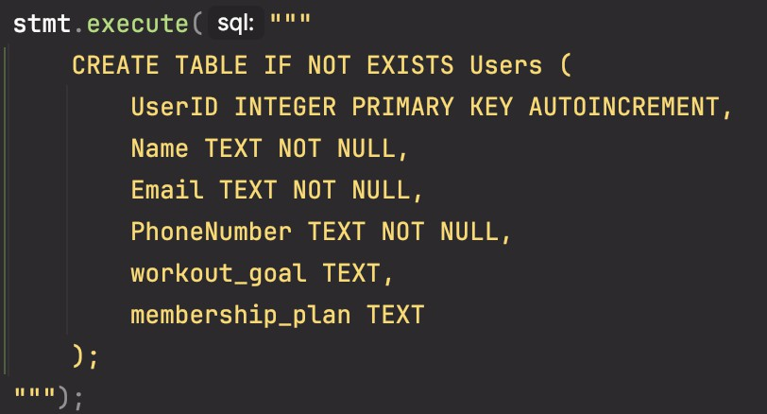
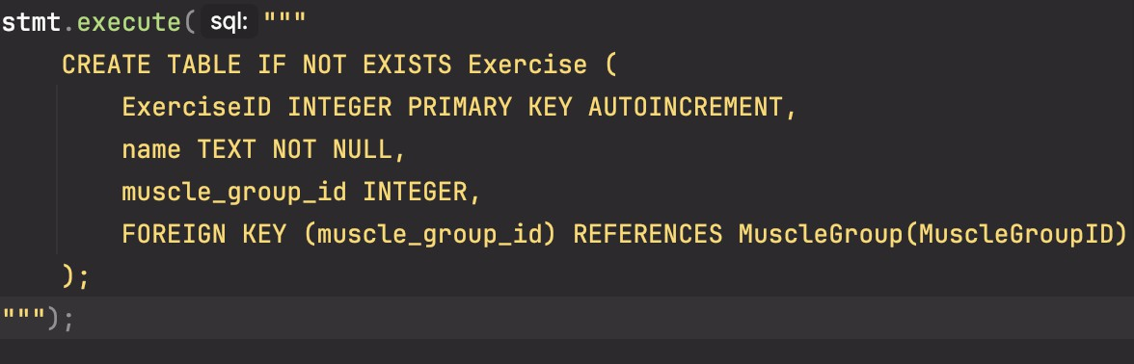
Creating Tables via Java

Slide 13
- 15 users
- Each with 5-day randomized plan
- Exercises, sets, reps, duration vary
Inserting Randomized Data

Slide 14
- Personalized 5-day plans
- Workout days: Push, Pull, Legs, Cardio,
Full Body
- 2–3 exercises/day
Special Features

Slide 15
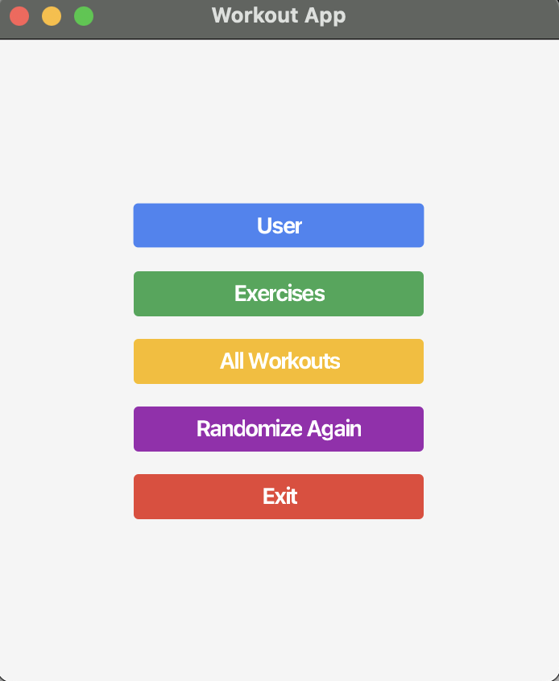
JavaFX GUI

Slide 16
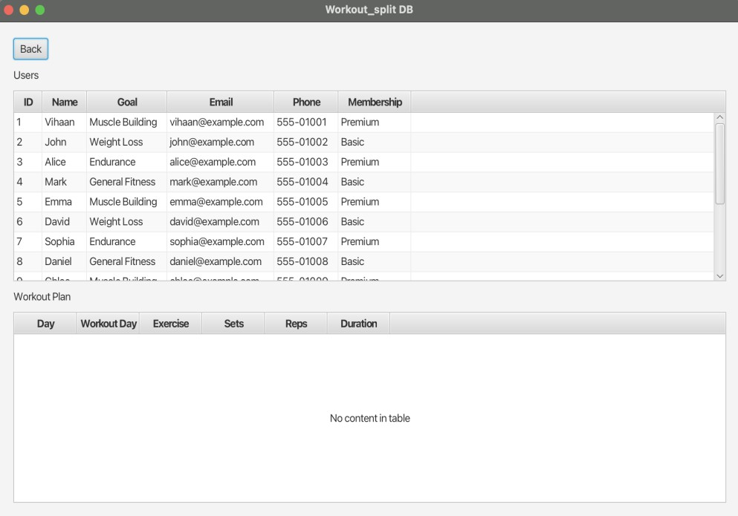
User View

Slide 17
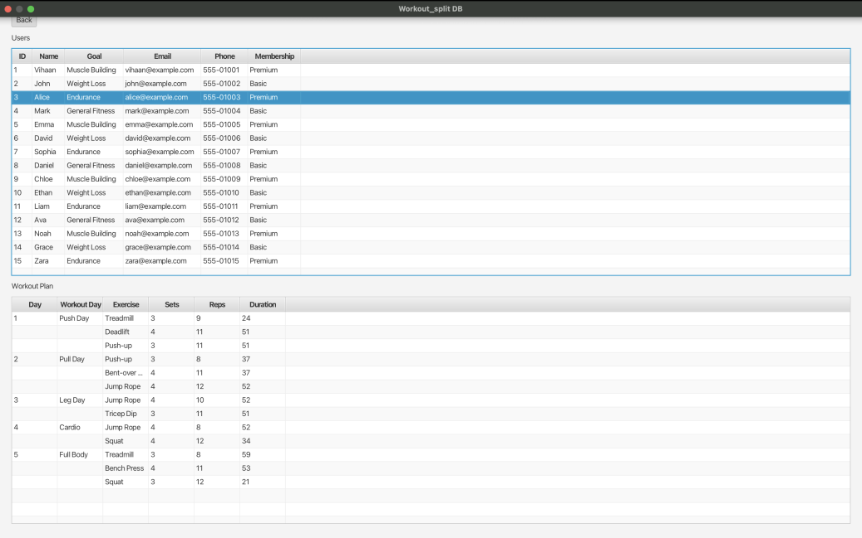
Workout Plan View

Slide 18
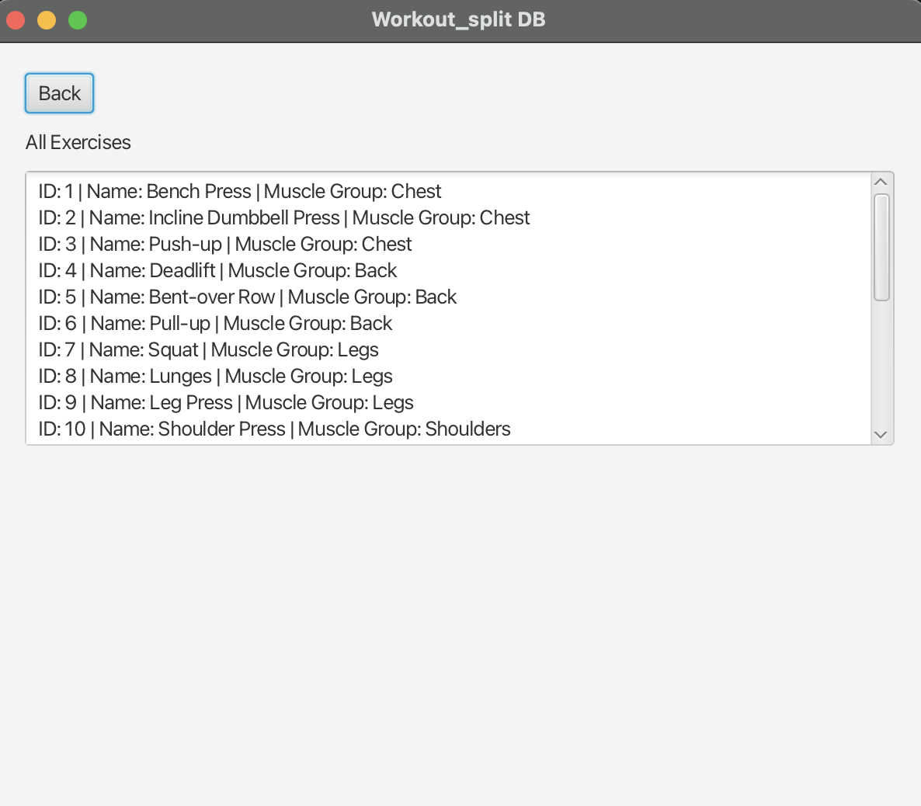
Exercise

Slide 19
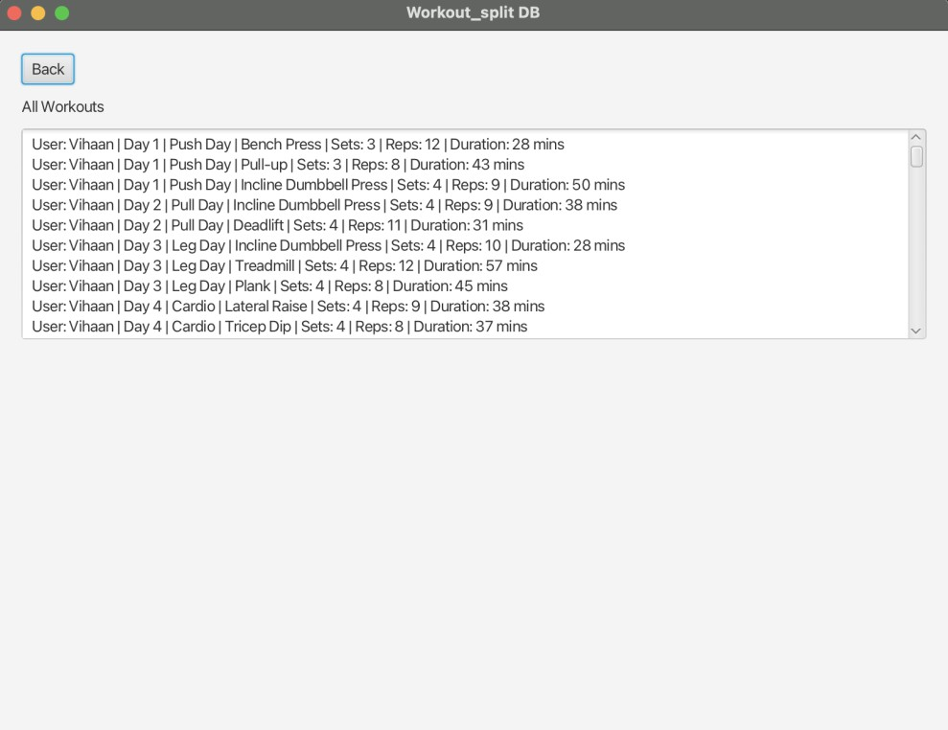
All Workouts View

Slide 20
The Workout Split Manager successfully integrates database principles with JavaFX to simulate a real-world gym scheduling system.
It demonstrates the practical use of ER modeling, SQL DDL/DML, JDBC, and Java GUI design in a cohesive project.
The system showcases how randomized, personalized workout routines can be dynamically generated and managed for multiple users.
Through proper table design, foreign key constraints, and normalized relationships, the project ensures both data integrity and flexibility.
Overall, this project reflects a strong understanding of how theoretical database concepts can be applied to solve real- world problems with intuitive, interactive software.
Conclusion

